Slide 1

ONLINE CLEANING SERVICE - WEB APPLICATION DEVELOPMENT PROJECT
By Phi - Quan - Nguyen

Slide 2
1
ABSTRACT
This presentation will introduce a online services booking service designed to streamline and enhance the user experience across various sectors.
The presentation aim to explain the working architecture of the project as well as give information of the role of each element in the website
The present will also briefly explore the strength, weakness of project as well as any challenges our team faced when building the website
International University | 2024

Slide 3
2
OVERVIEW
Introduction
Discussion and Conclusion
Requirement Analysis and Design
References
Implementation
Thank You
International University | 2024

Slide 4
INTRODUCTION
3
Purpose
Features
Limitation
Creating a web application for commercial cleaning services to improve booking efficiency, ensure transparency in service delivery, and streamline contracts and payments.
Booking services online with 3 choices of Options (Basic, Pro, Deluxe)
Apply api call to sent and receive payment with Paypall
Able to check the progression of any chosen task
Limited to one service type per day,
Single task per staff per day, cash and PayPal payments in-person only
Limited services.

Slide 5
4
REQUIREMENT ANALYSIS AND DESIGN
International University | 2024

Slide 6
5
A. USE CASE
Centralize around the three main actors: User, Staff, Examiner
1
User: Log in/register, log out, update profile, view services and pricing, book service and make payment, check service and contract status.
International University | 2024
2
Staff: Log in to view assigned tasks, log out, update profile, update task status (pending → complete).
3
Examiner: Log in to review tasks, log out, update profile, approve contracts after verification (update contract status).

Slide 7
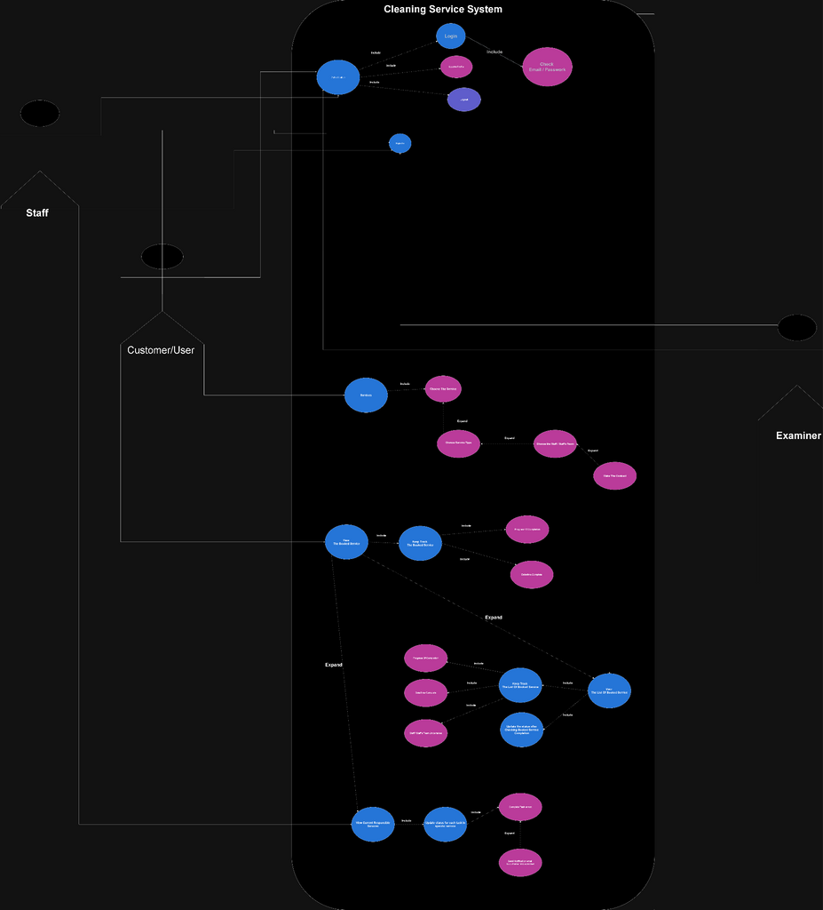
6
International University | 2024
Picture: Use Case Diagram of our website

Slide 8
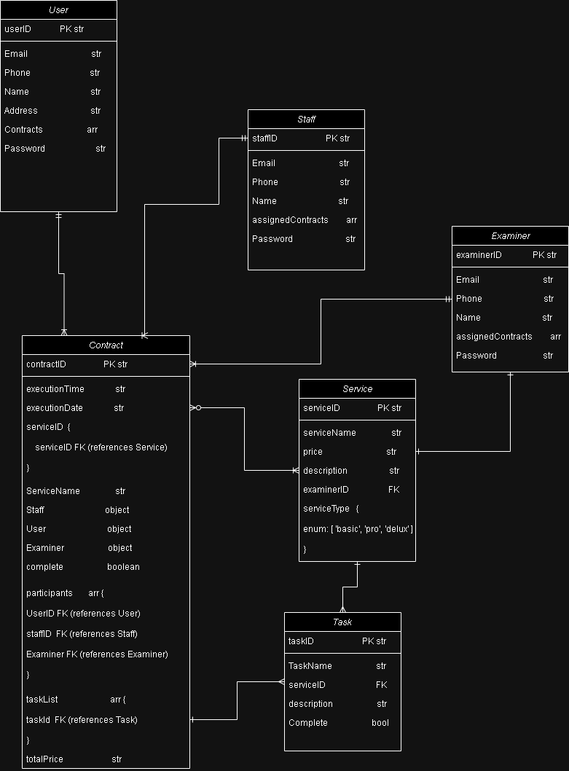
B. CLASS DIAGRAM
7
International University | 2024

Slide 9
8
C. ARCHITECTURE
1
Presentation Layer (view): React/HTML pages for users, staff, examiners and default company pages.
International University | 2024
Business Logic Layer (controller): Node.js backend handling service bookings, task updates, staff, user, examiner action and contract approvals.
2
3
Data Layer (model): MongoDB database storing data for users, staff, examiner, tasks, and contracts.

Slide 10
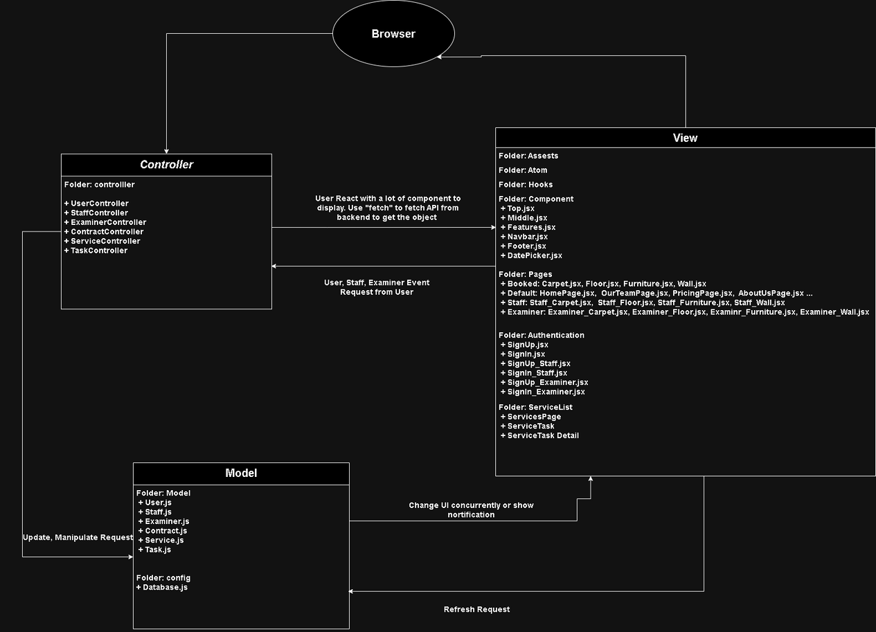
9
International University | 2024
Picture: Diagram components of our website

Slide 11
10
IMPLEMENTATION
Default Company Pages
User’s Role
Staff’s Role
Examiner’s Role
International University | 2024

Slide 12
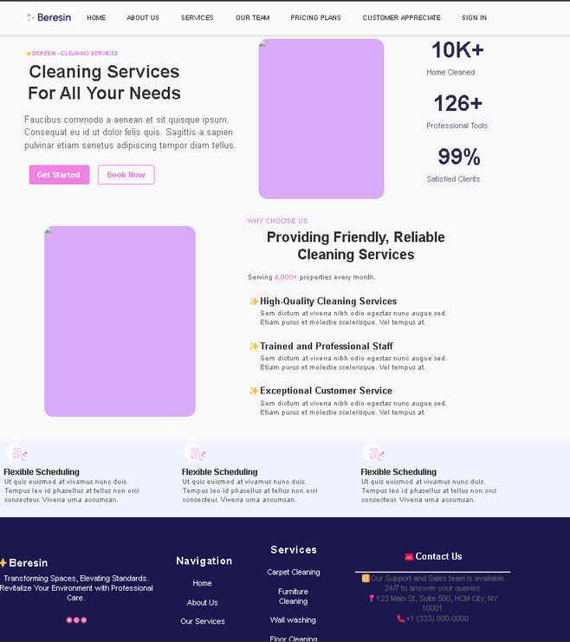
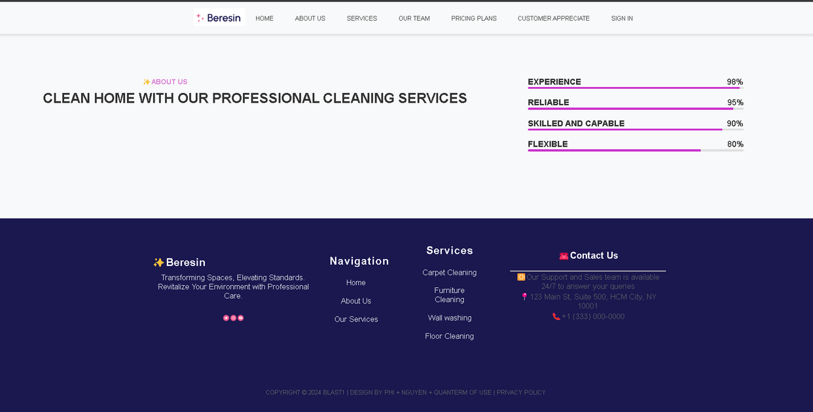
11
A. DEFAULT COMPANY PAGES
About us page
Home page
International University | 2024

Slide 13
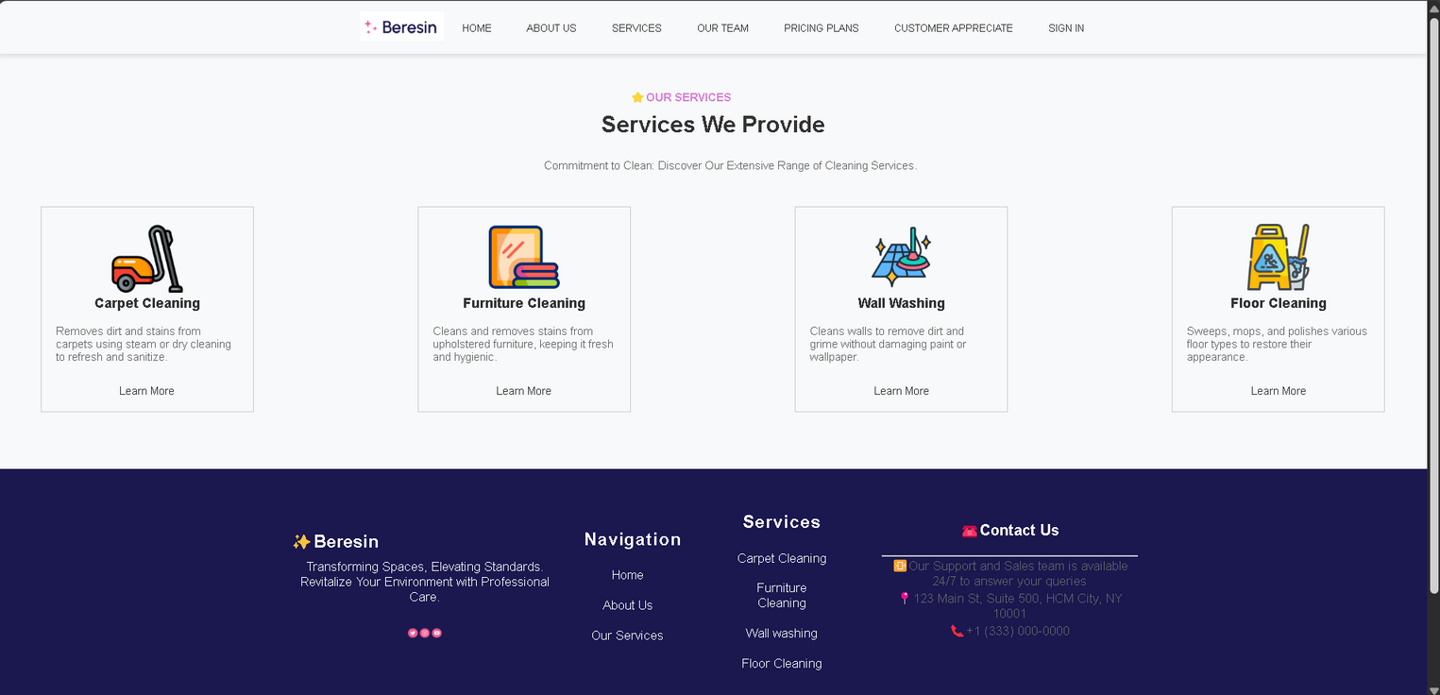
12
A. DEFAULT COMPANY PAGES
Services Page
International University | 2024

Slide 14
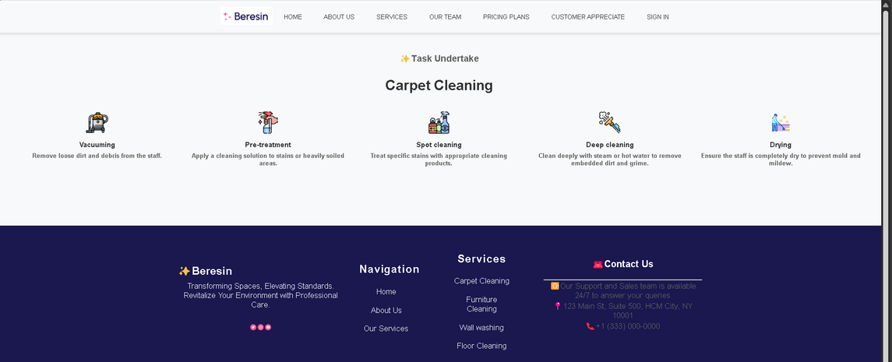
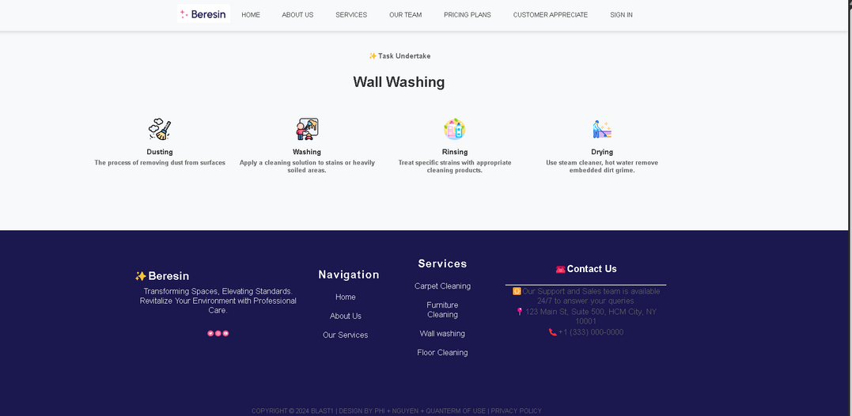
13
DETAIL TASK FOR EACH SERVICE
Wall Washing Page
Carpet Cleaning Page
International University | 2024

Slide 15
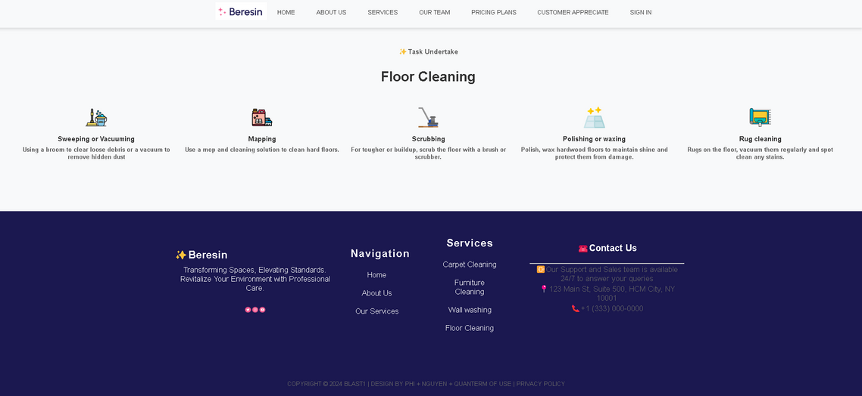
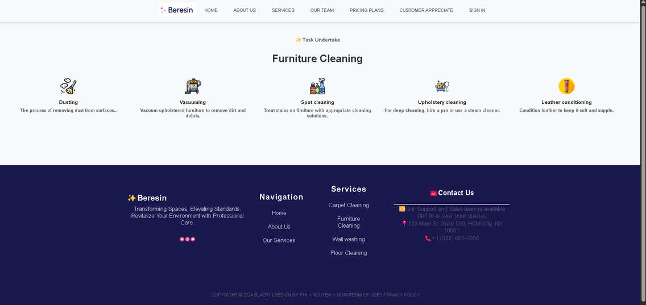
14
DETAIL TASK FOR EACH SERVICE
Furniture Cleaning Page
Floor Cleaning Page
International University | 2024

Slide 16
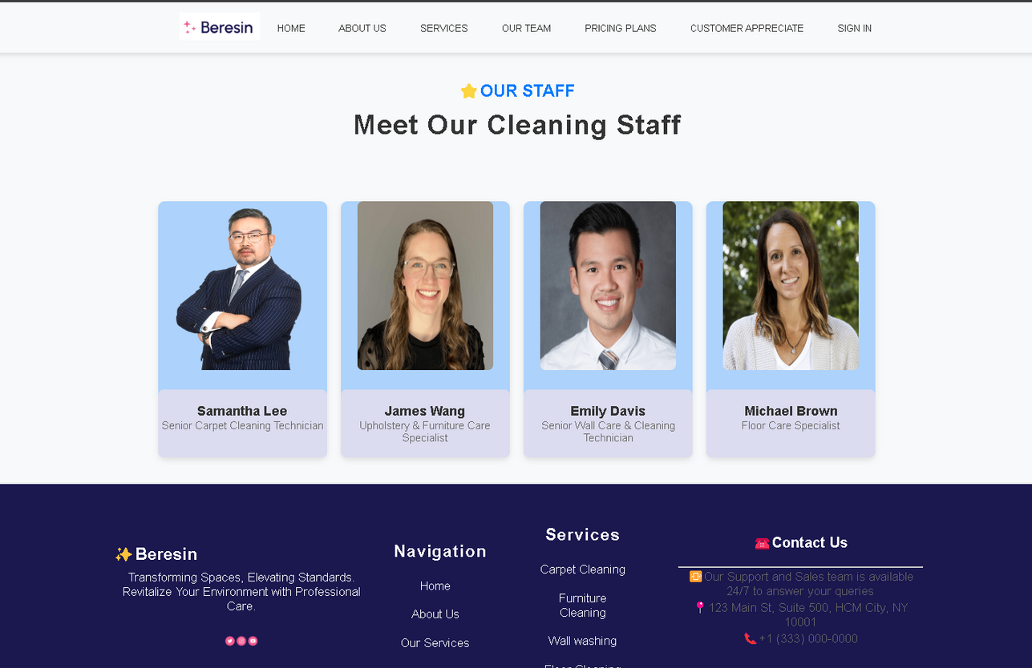
15
A. DEFAULT COMPANY PAGES
Our Team Page
International University | 2024

Slide 17
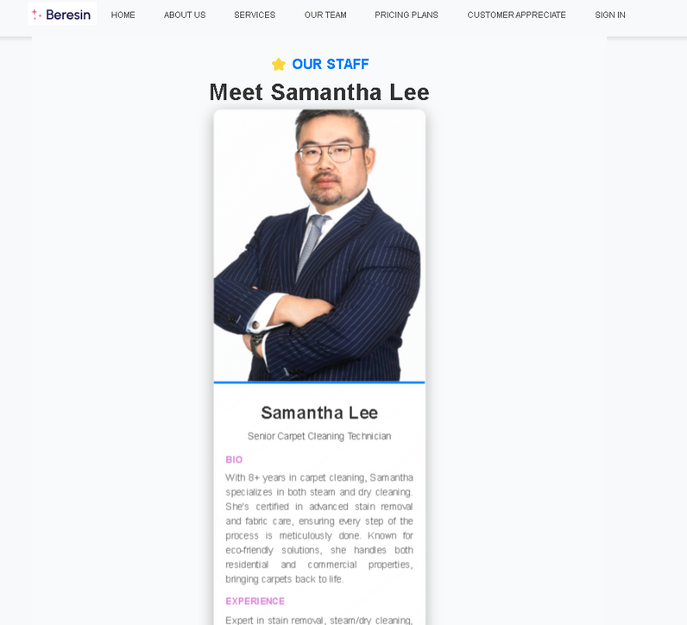
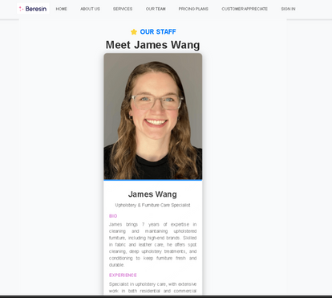
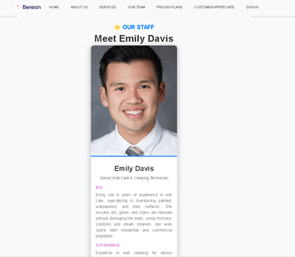
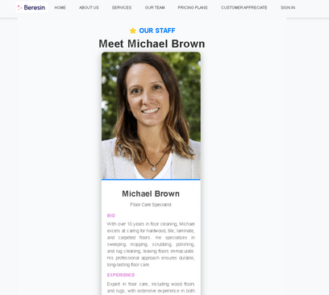
16
STAFF BIOS
Example Staff Bio
The other bios
International University | 2024

Slide 18
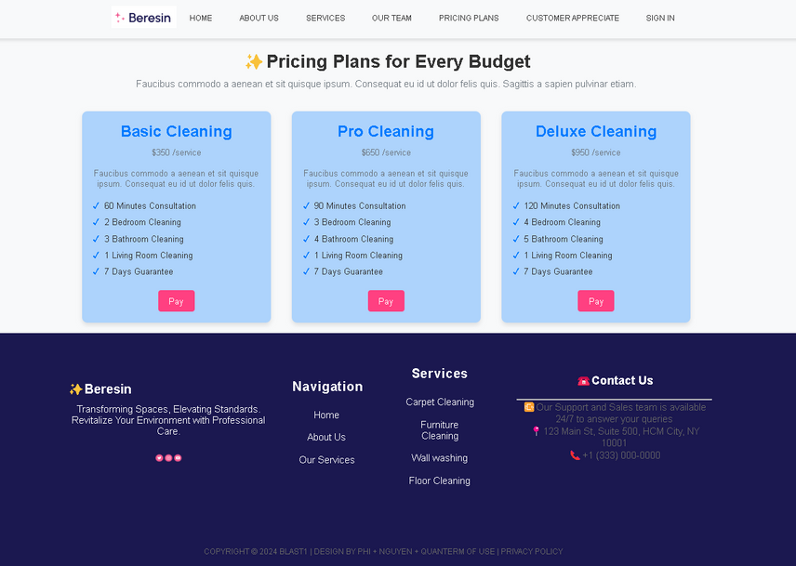
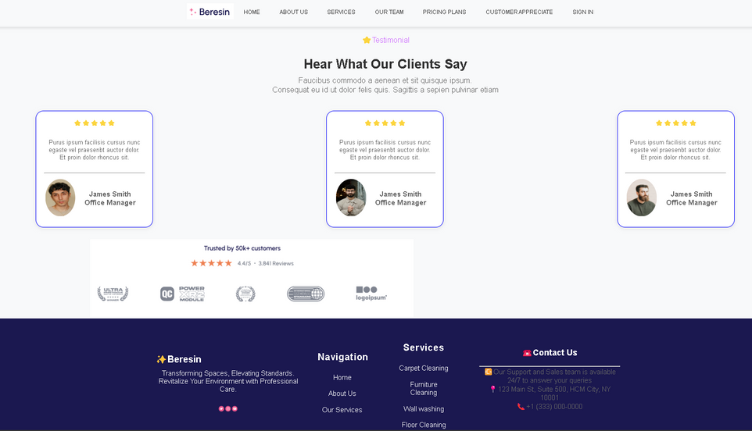
17
A. DEFAULT COMPANY PAGES
Pricing Plan Page
Customer Appreciation Page
International University | 2024

Slide 19
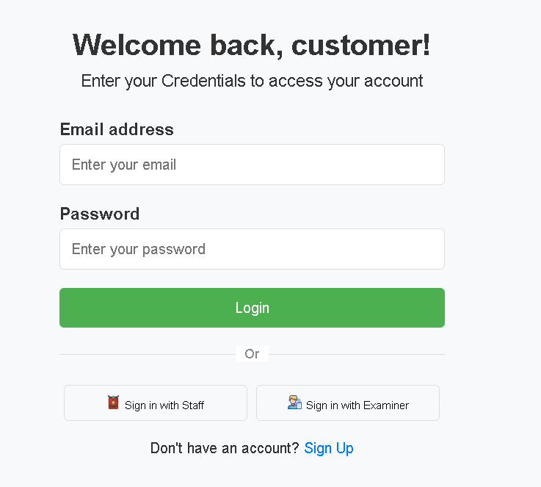
B. USER’S ROLE
18
Steps / Action order
Login
View services
Book needed services
Make payment
Track task status
International University | 2024
Login Screen

Slide 20
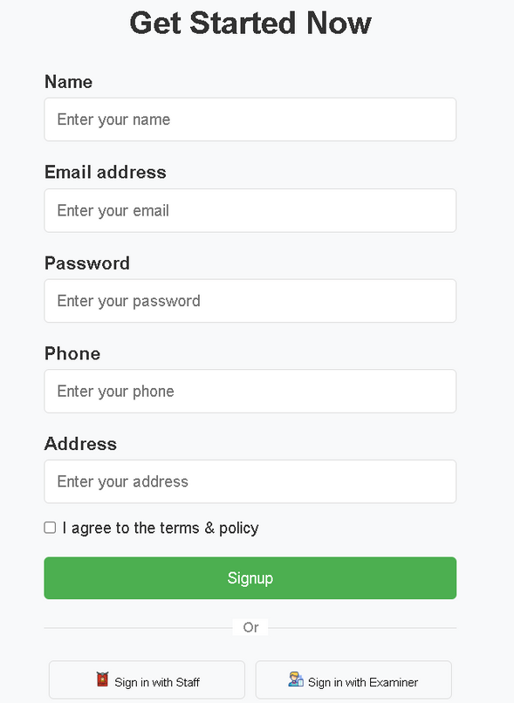
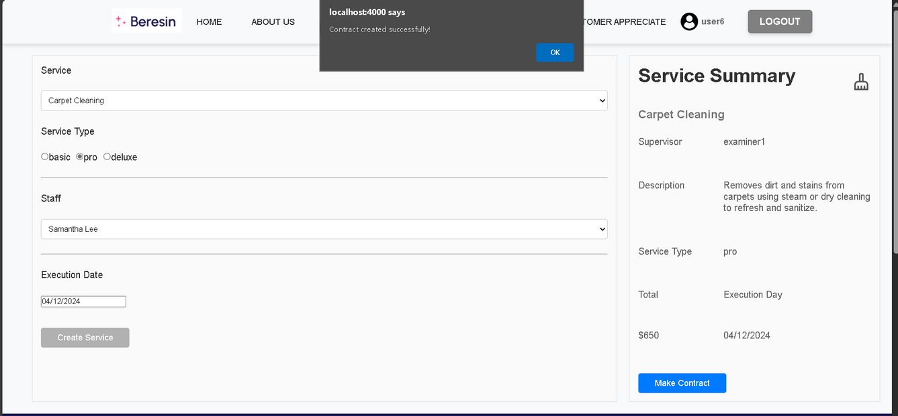
19
B. USER’S ROLE
Select service with Services Selection Screen
Sign Up Screen
International University | 2024

Slide 21
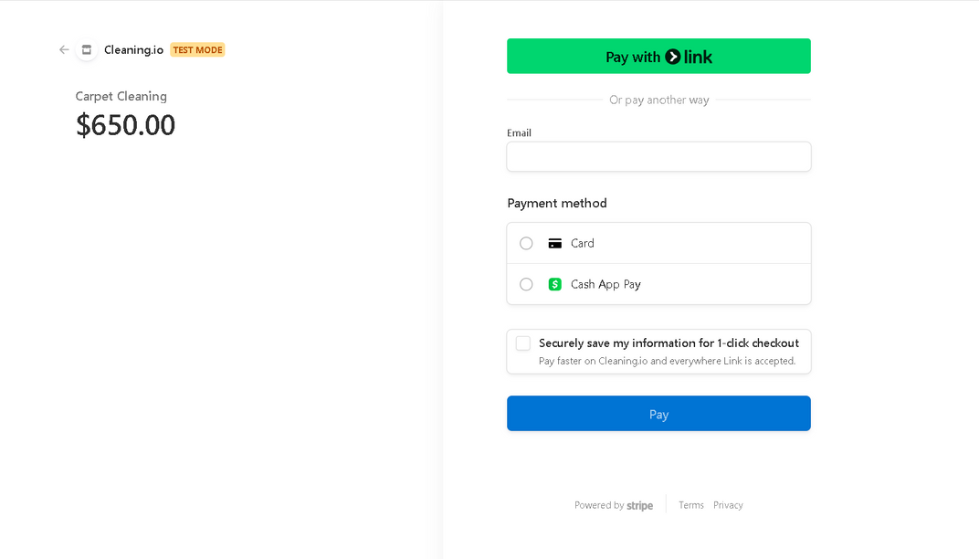
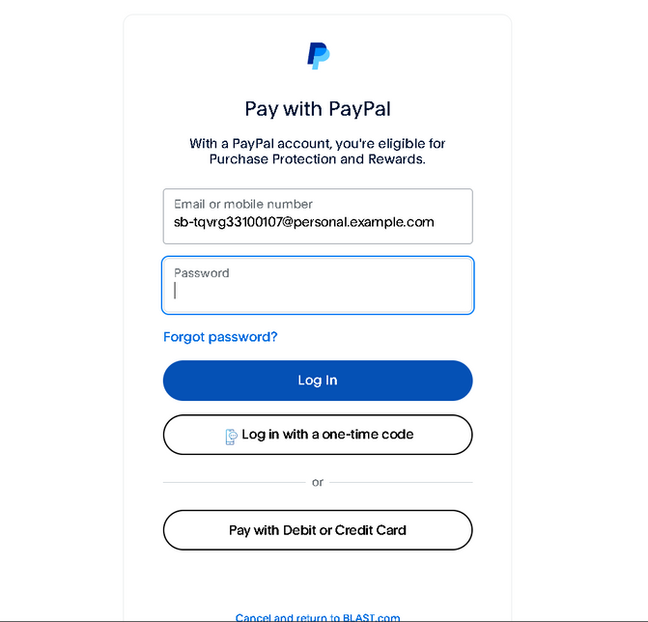
20
B. USER’S ROLE
Users can pay either through PayPal or by card
PayPal payment interface
Payment by Card with Link
International University | 2024

Slide 22
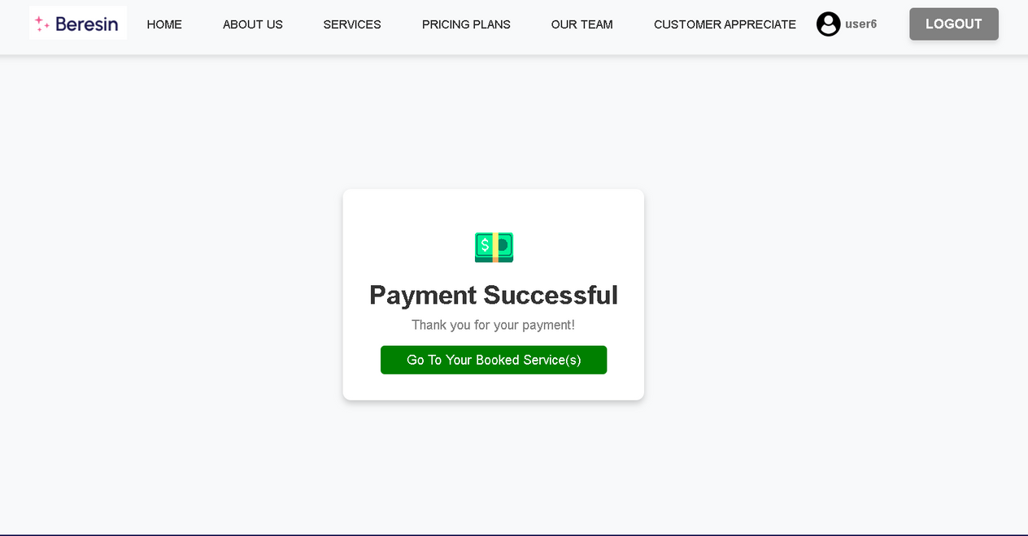
21
B. USER’S ROLE
Users can pay either through PayPal or by card
Payment Success Screen
International University | 2024

Slide 23
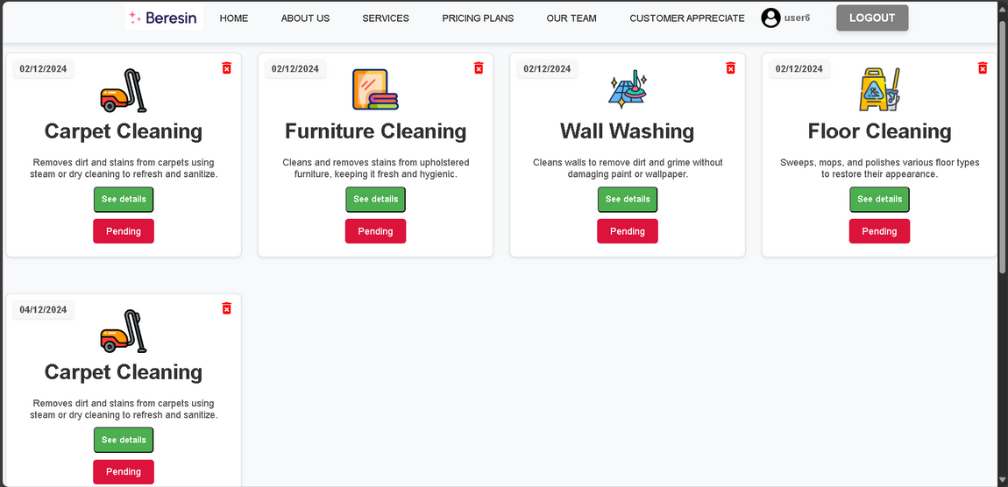
22
B. USER’S ROLE
Users can keep track of their booked service via Booked Services Page
Booked Services Page
International University | 2024

Slide 24
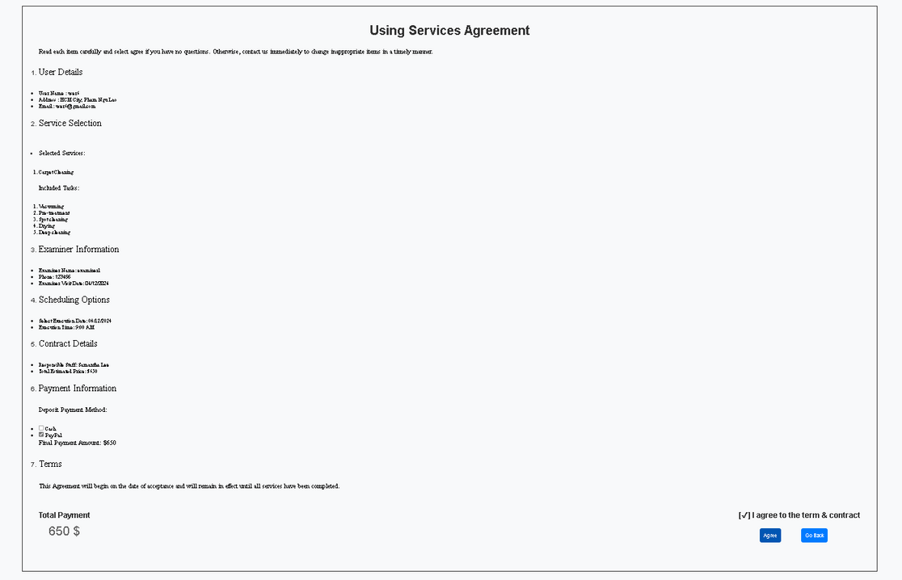
23
B. USER’S ROLE
Confirm services with User Agreement
International University | 2024

Slide 25
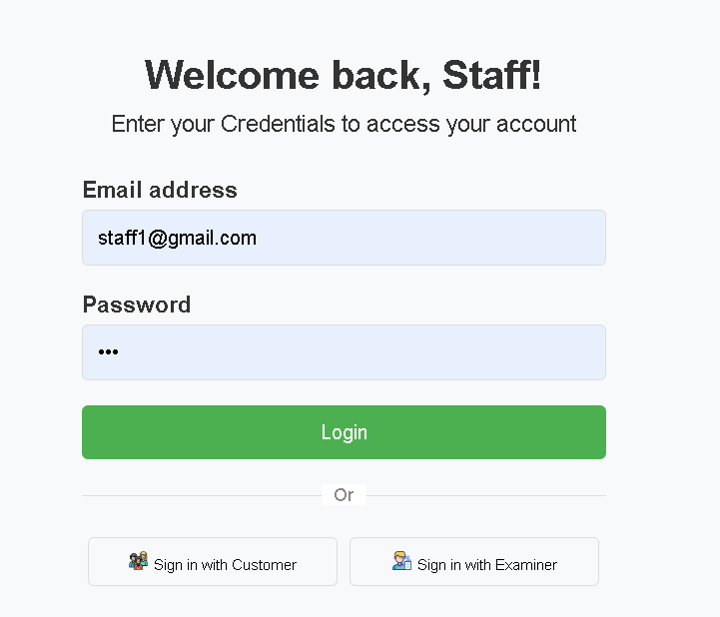
C. STAFF’S ROLE
24
Steps / Action order
Login through Staff Portal
View assigned tasks
Update task status when complete
Track overall progress
International University | 2024
Login Screen

Slide 26
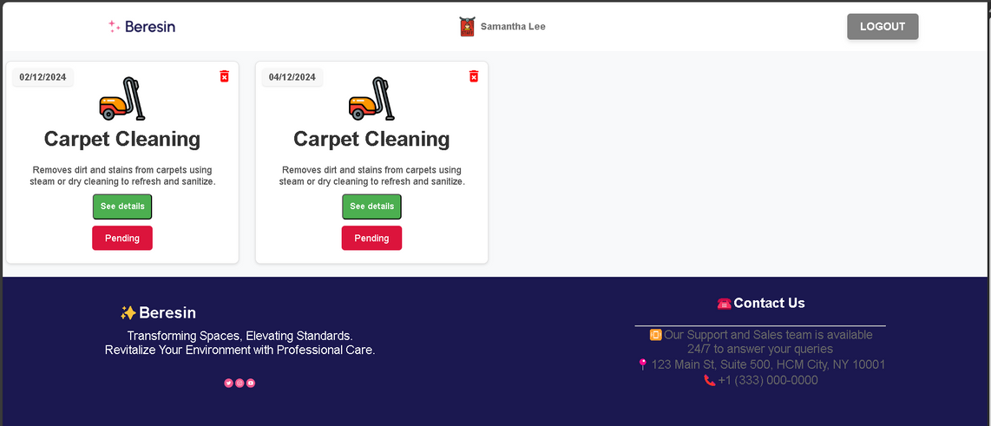
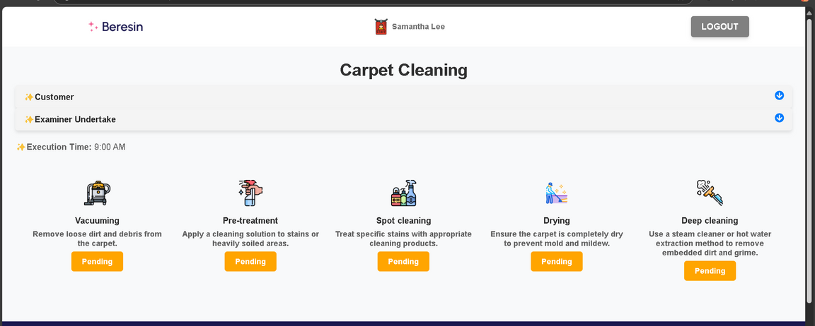
25
C. STAFF’S ROLE
Staffs can manage their assigned tasks in Task Management Interface
And view detail of tasks in Associated Tasks Section
Task Manager Interface
Asscociated Tasks Section
International University | 2024

Slide 27
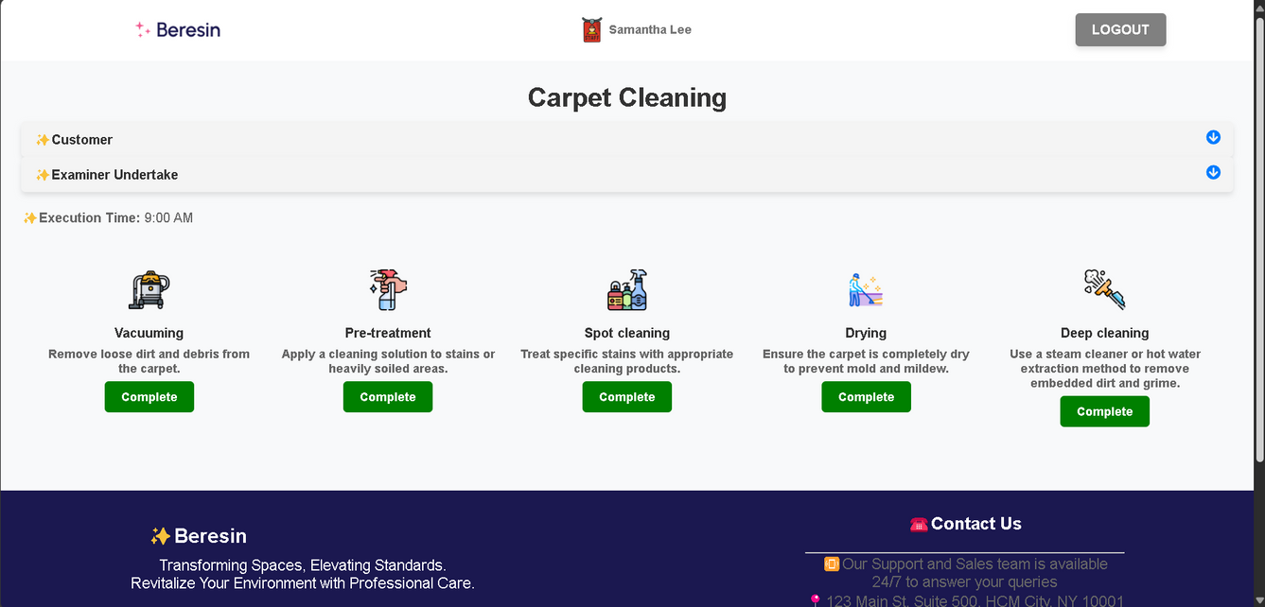
26
C. STAFF’S ROLE
Finally, staffs can change their task status when they finish it
Change task status
International University | 2024

Slide 28
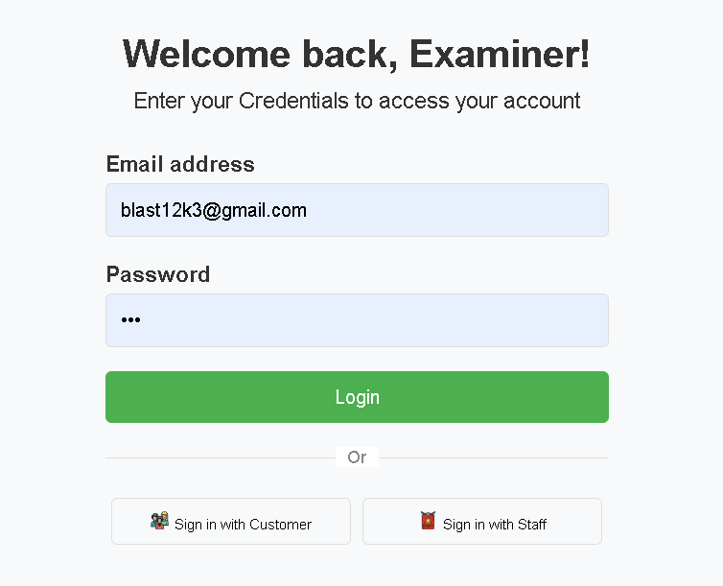
D. EXAMINER’S ROLE
27
Steps / Action order
Login
Review booked contracts
Approve/Verify task completion
Mark finished tasks
International University | 2024
Login Screen

Slide 29
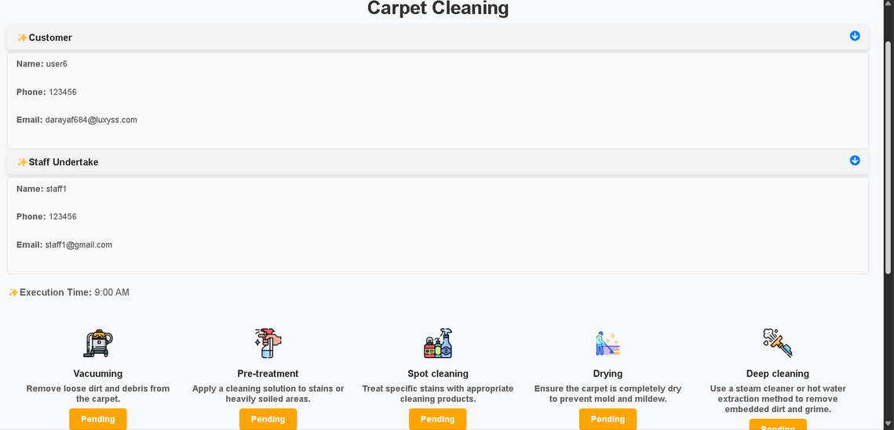
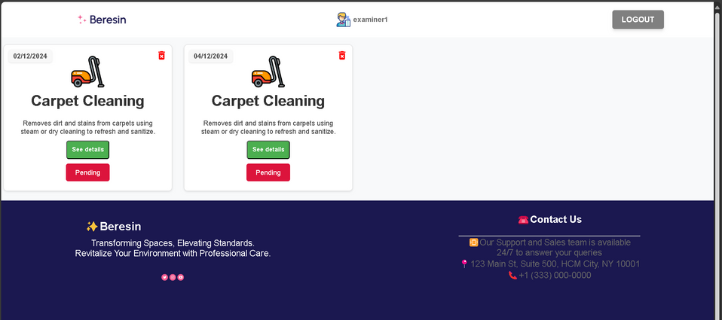
28
D. EXAMINER’S ROLE
Examiners can view customer’s booked tasks in Examiner Management Interface
And approve booking with Approval Interface
Examiner Manager Interface
Approval Interface
International University | 2024

Slide 30
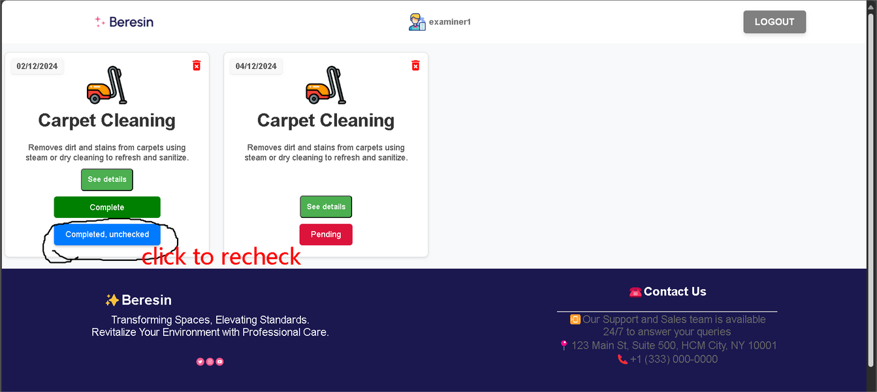
29
C. STAFF’S ROLE
Finally, examiners can recheck and confirm staff’s task completion
Recheck and confirm completion
International University | 2024

Slide 31
30
DISCUSSION AND CONCLUSION
Challenges
Strengths
Weaknesses
Ensuring real-time updates
Managing dependencies
Handling overlapping
Easy to use for both users and staffs
Flexible payment options for users
Limited to single-day service contracts
Cash and Paypal payments restricted to in-person
The main services are not flexible
International University | 2024

Slide 32
REFERENCES
31
Books/Articles:
"Designing Data-Intensive Applications" by Martin Kleppmann
“Clean Architecture" by Robert C. Martin.
Websites
Documentation for React, Node.js, and MongoDB:
https://react.dev/
https://nodejs.org/en
https://www.mongodb.com/
Guides for creating use case and class diagrams:
https://www.figma.com/resource-library/what-is-a-use-case/
https://www.geeksforgeeks.org/unified-modeling-language-uml-class-diagrams/
International University | 2024

Slide 33
International University | 2024
THANK YOU
Presented By : Nguyễn Trọng Nguyên

